Slide 1
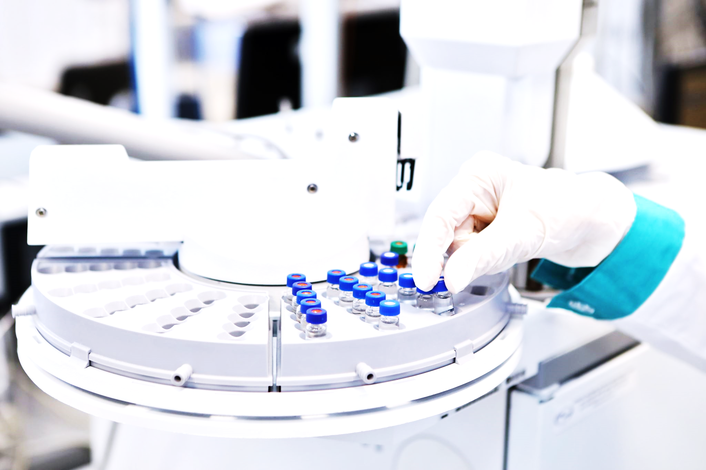
Predicting Diabetes Using Machine Learning Models
Project 2, Group 3:
Michael Leston and Giselle Gomez

Slide 2
Agenda
Executive Summary
Data Collection, Cleaning and Transformation
Exploratory Data Analysis & Visualizations
Baseline Model Evaluation
Model Implementation
Model Optimization and Final Performance
Results and Conclusions
Future Considerations
Resources

Slide 3
Executive Summary
Problem: Predict whether a patient has diabetes based on medical and demographic data.
Objective: Develop a machine learning model to achieve high classification accuracy (75%+).

Slide 4
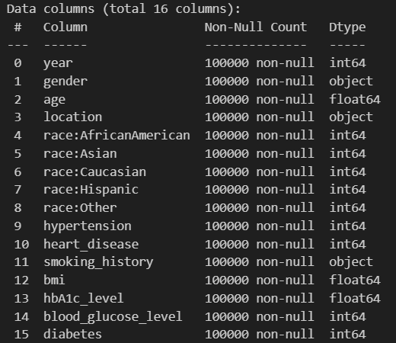
Data Collection, Cleaning and Transforming
No missing values
3 cat. and 13 numeric variables
Target variable:
(0: No diabetes, 1: Diabetes)
Renaming columns for clarity
Handling duplicates
Values_counts of categorical variables
Uninformative columns

Slide 5
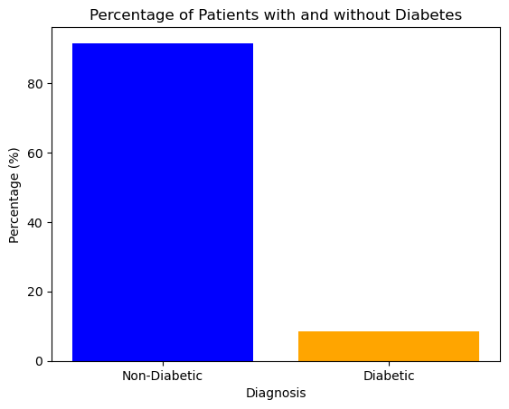
EDA and Visualizations
Checking for class imbalance
Non-Diabetic : 91.5%
Diabetic : 8.5 %

Slide 6
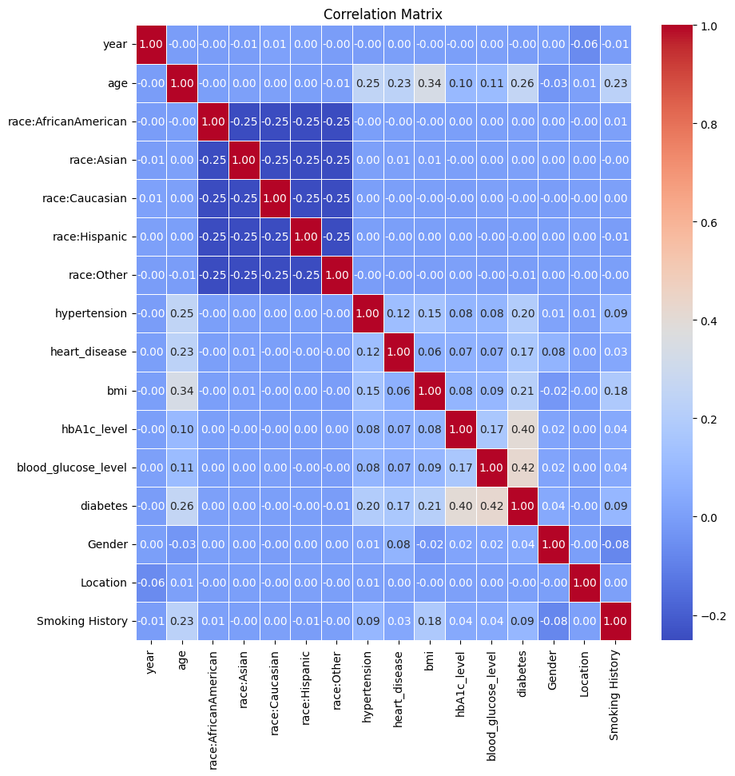

Slide 7
Baseline Models
Model | Train Acc | Test Acc | Recall | F1 | MCC | ROC-AUC
LogReg | 0.97253 | 0.97216 | 0.68836 | 0.81076 | 0.81126 | 0.97590
RF | 0.99985 | 0.96872 | 0.66358 | 0.78575 | 0.78505 | 0.95710

Slide 8
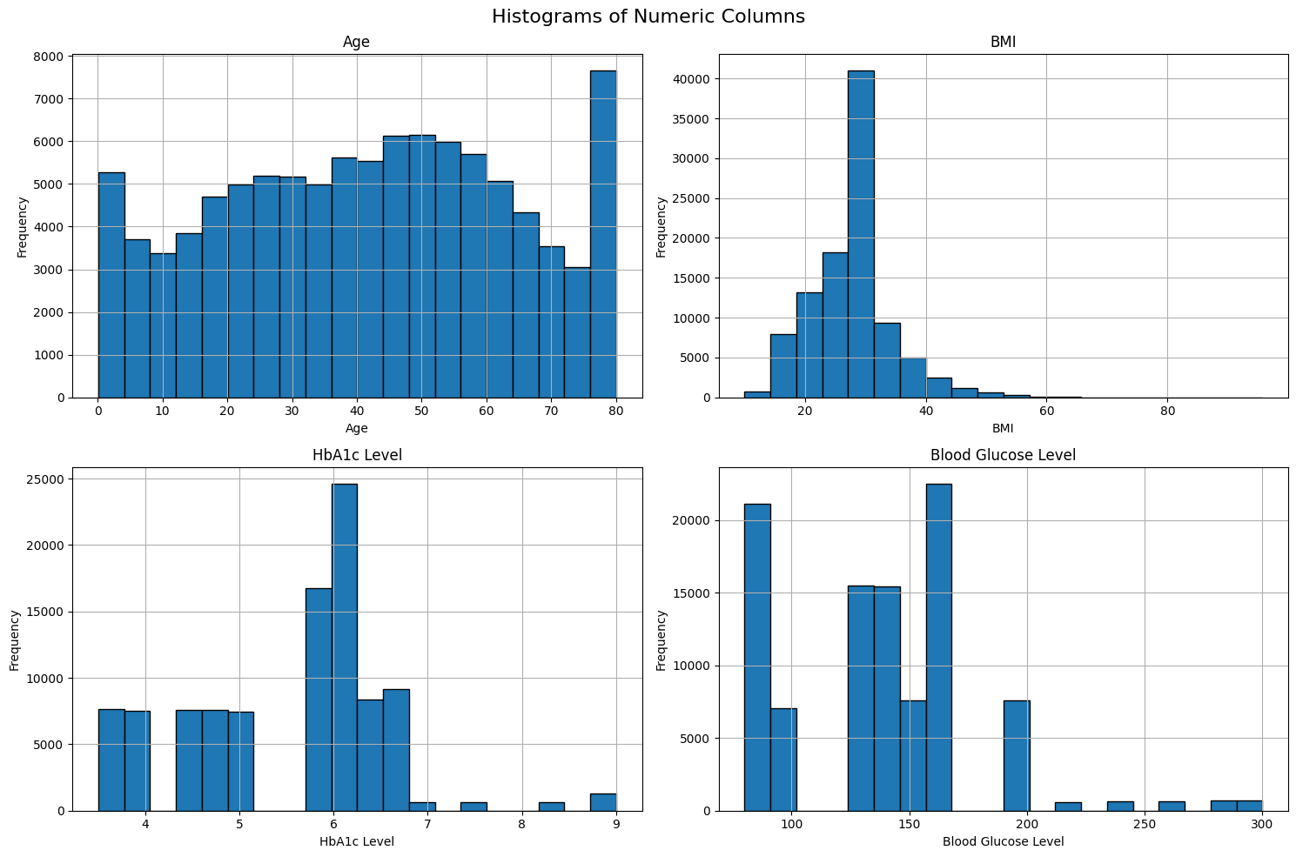

Slide 9
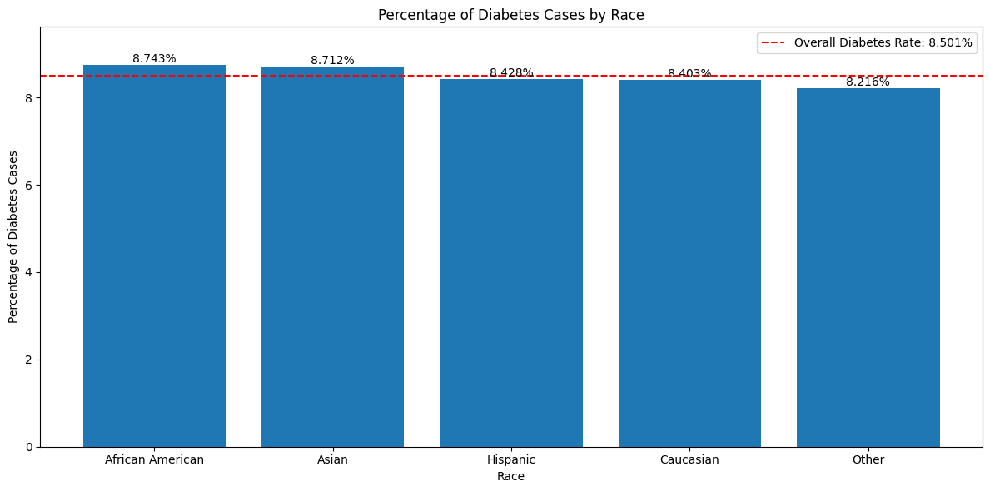

Slide 10
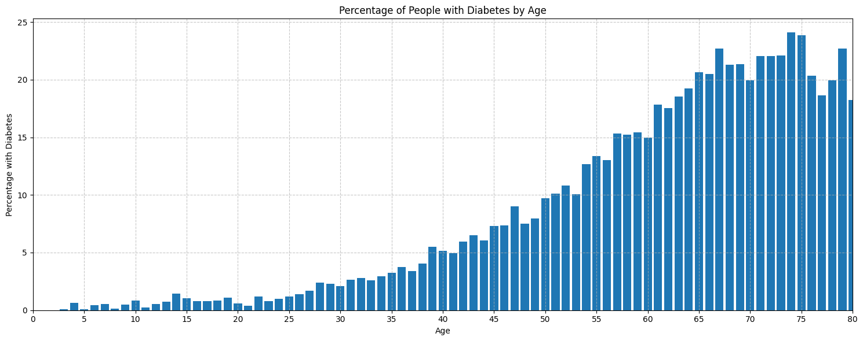

Slide 11
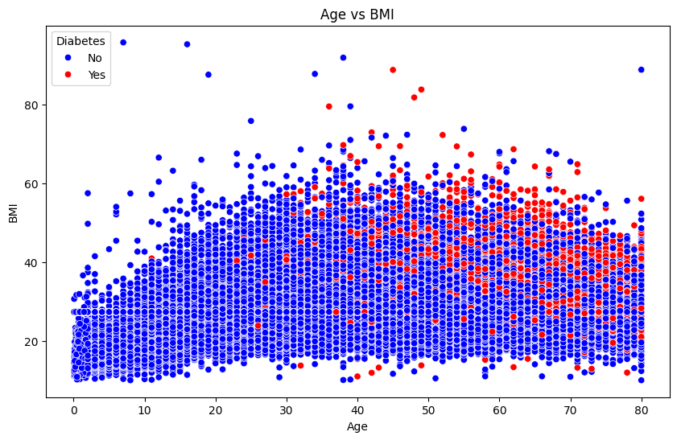

Slide 12
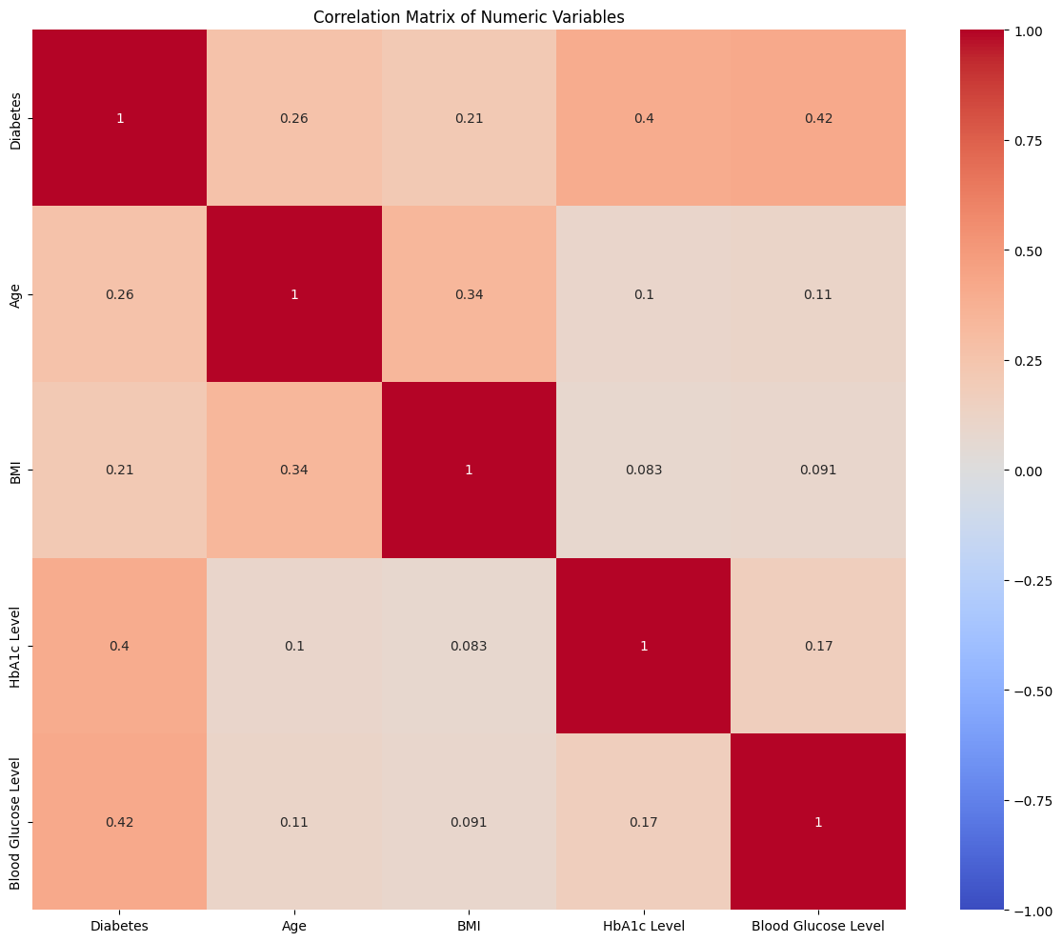
Correlation with Diabetes:
Blood Glucose Level - 0.42
HbA1c Level - 0.40
Age - 0.26
BMI - 0.21

Slide 13
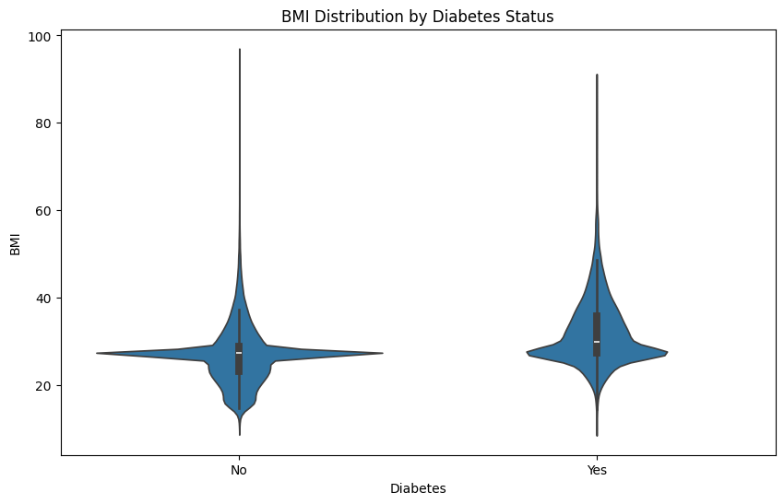

Slide 14
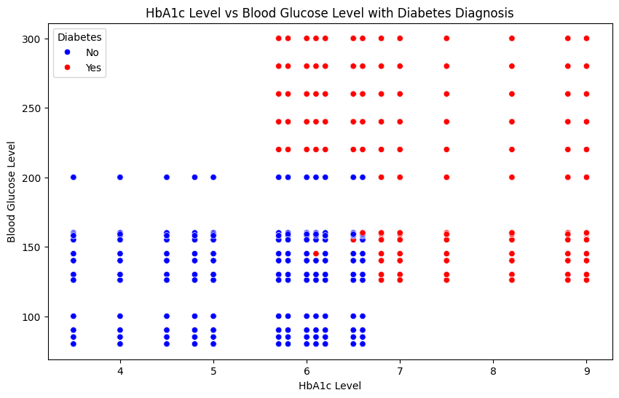

Slide 15
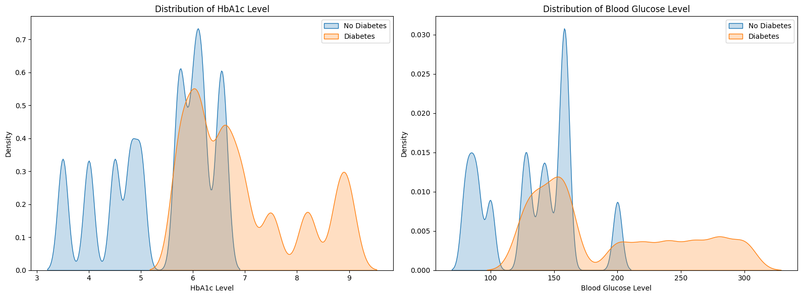
KDE Plots

Slide 16
Feature Engineering
‘HbA1c Category’ - based on medical thresholds
‘BMI_Category’ - based on medical thresholds
‘Blood_Glucose_Category’ - based on medical thresholds
‘Combined Risk Factors: 0 - None, 1 - ‘Heart Disease’ or ‘Hypertension’, 2 - Both
‘Smoking History Grouped - Combining similar categories
‘Cluster’ - Resulting clusters from applying KMeans to BMI, HbA1c Level, and Blood Glucose Level

Slide 17
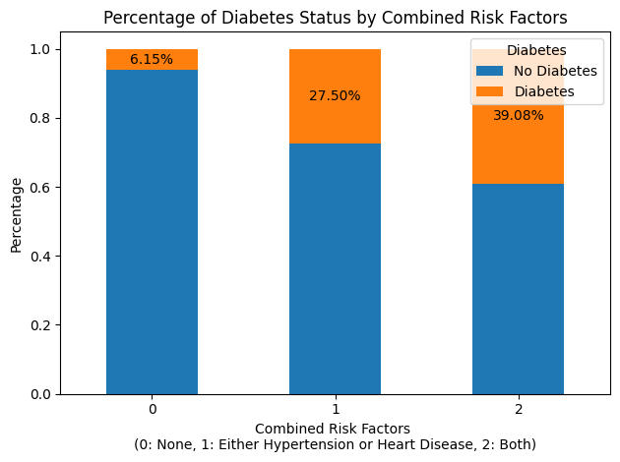

Slide 18
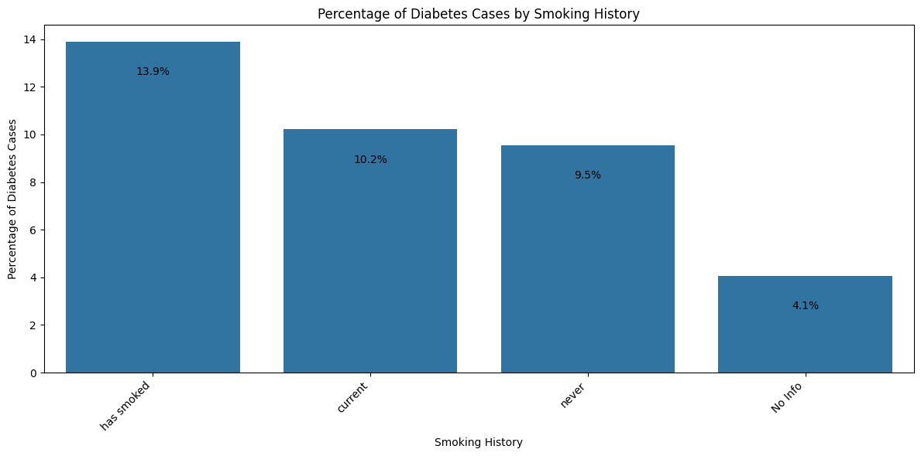
Original categories : former, ever, not current, current, never, no info

Slide 19
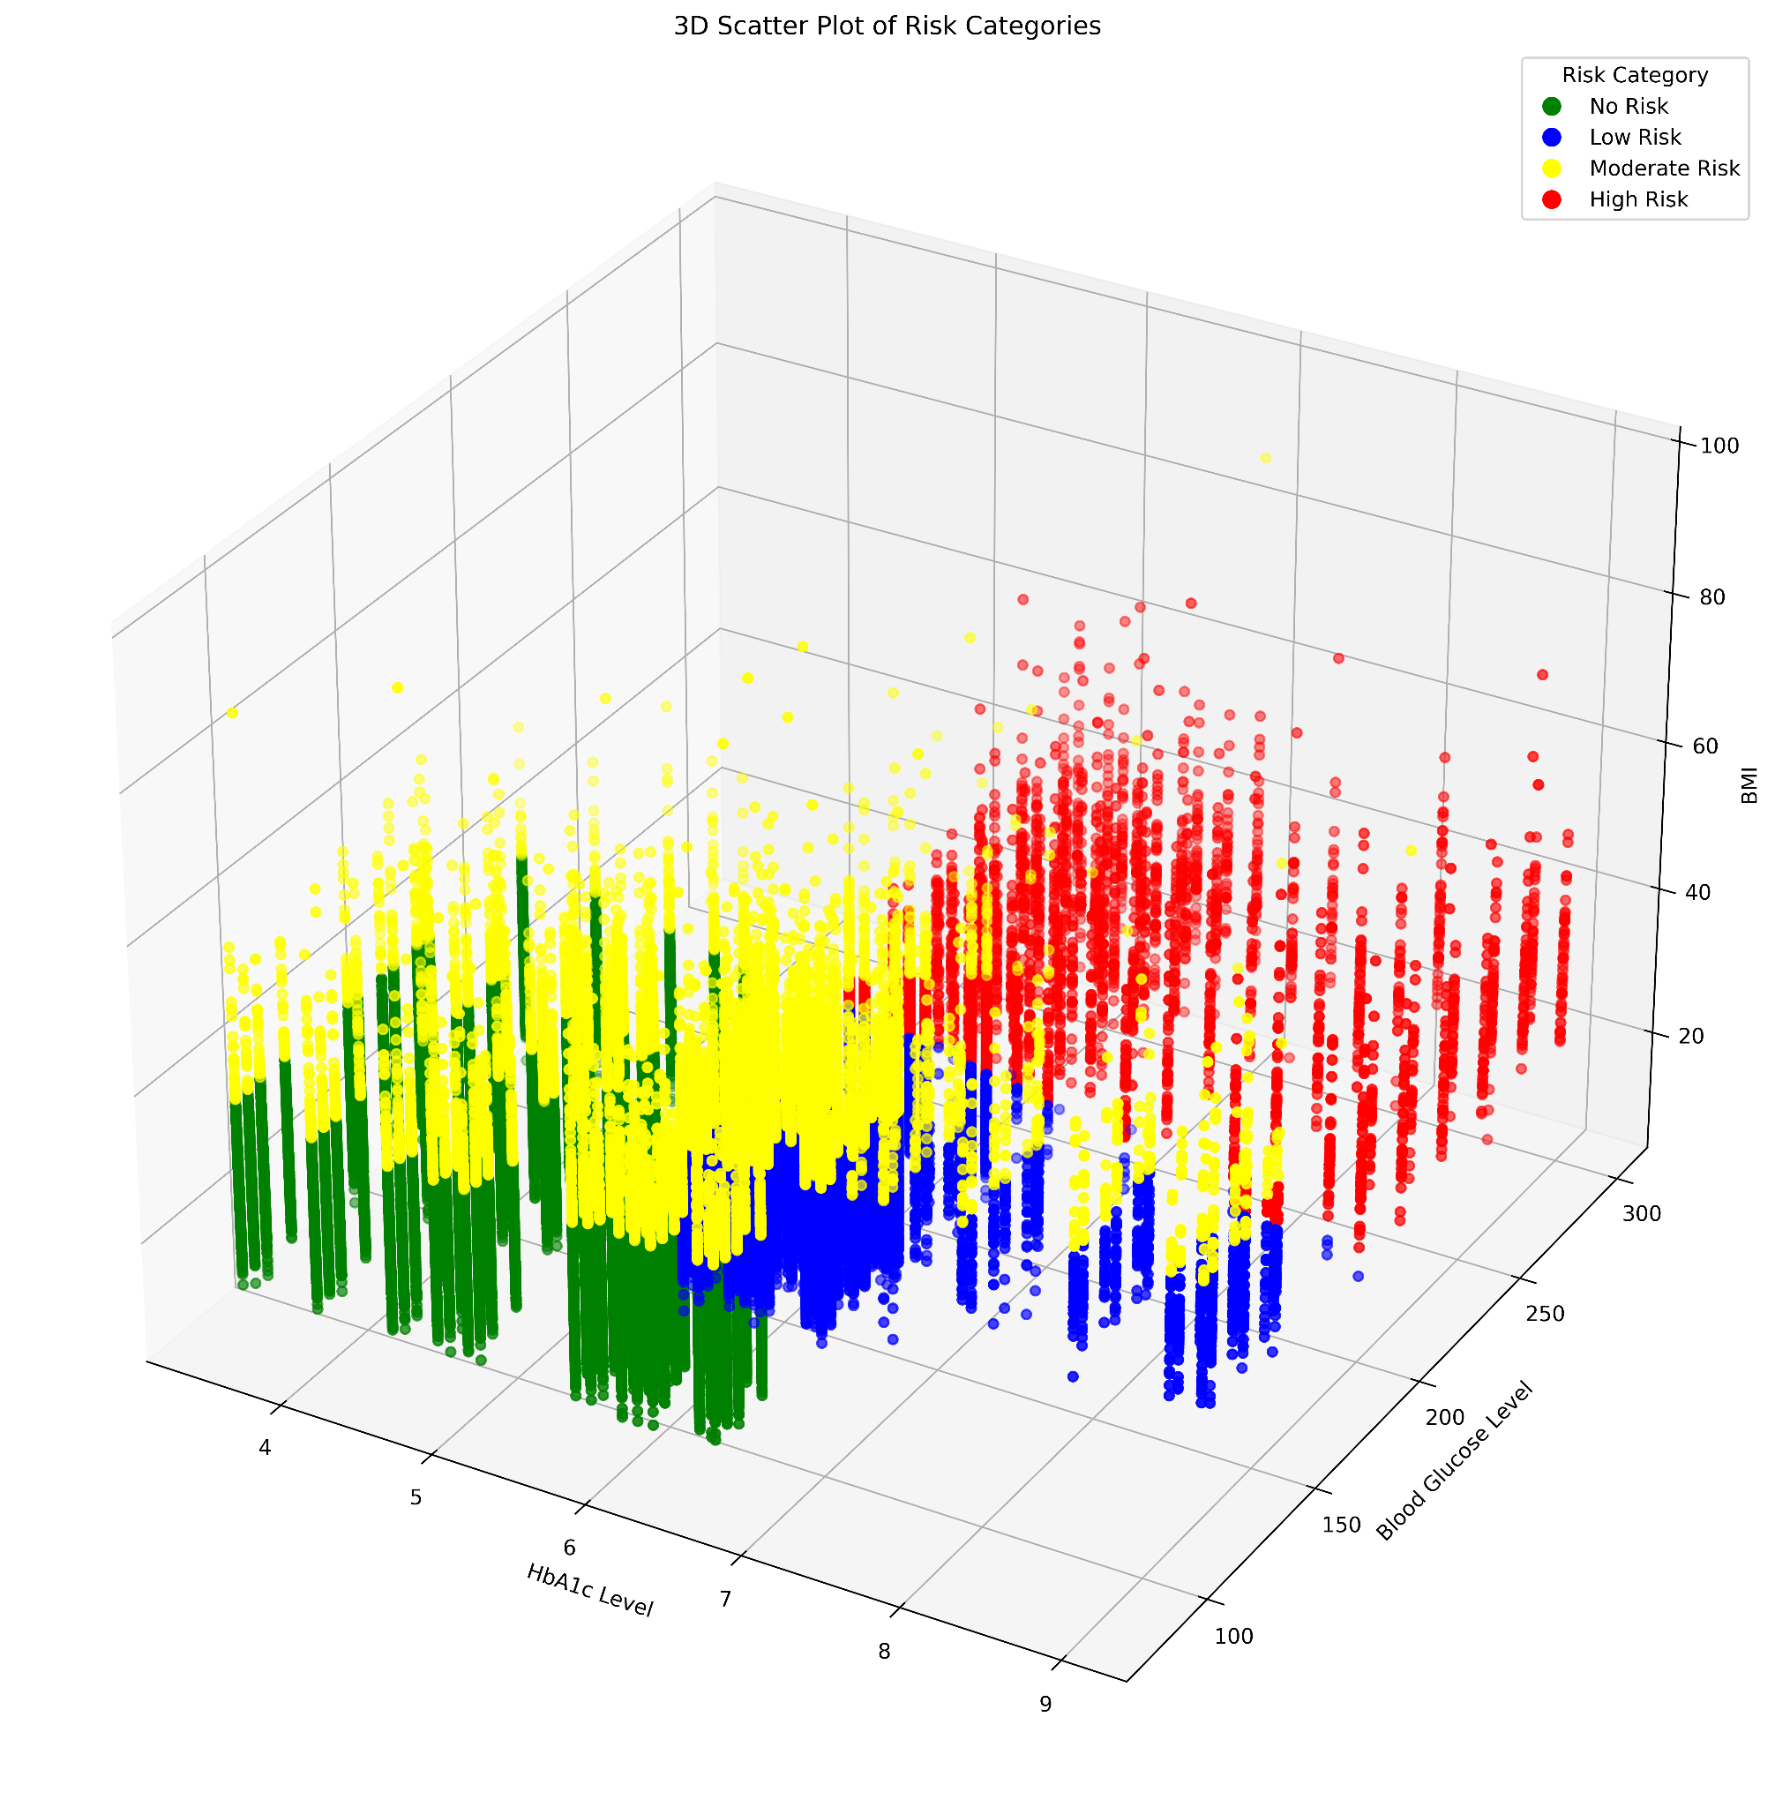
Apply KMeans clustering
Apply “Risk Category” levels
Create 3d Scatterplot

Slide 20
Model Testing
Logistic Regression
RandomForest
Decision Tree
LightGBM
xgBoost
AdaBoost

Slide 21
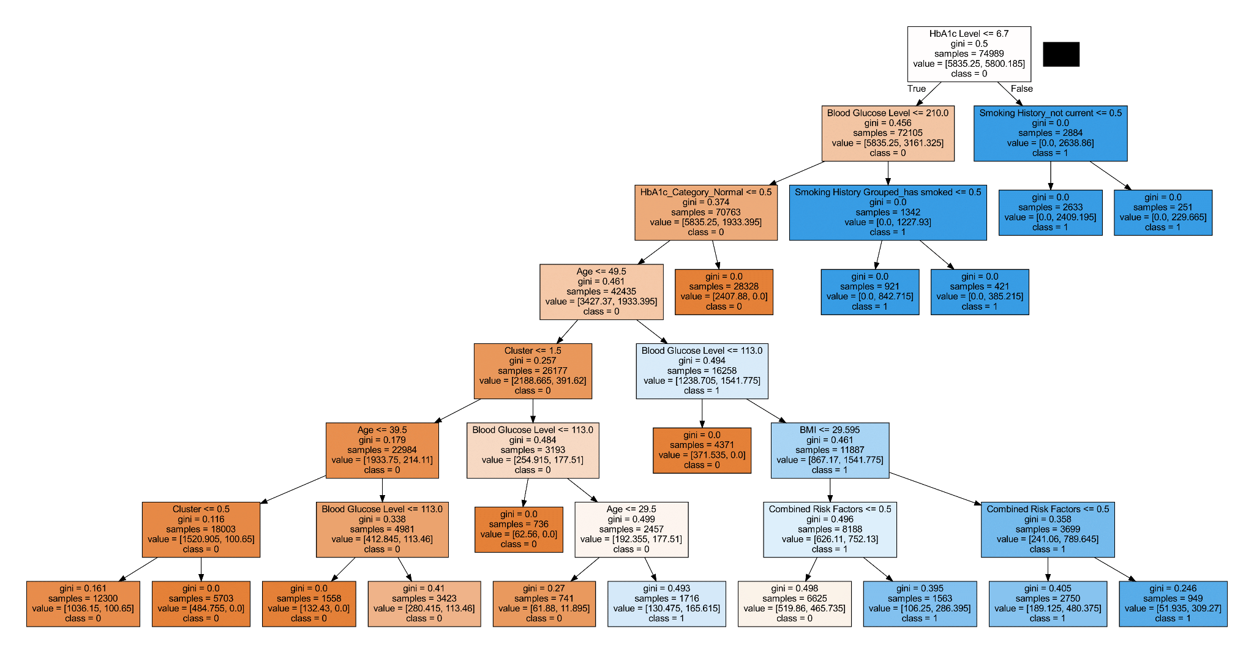

Slide 22
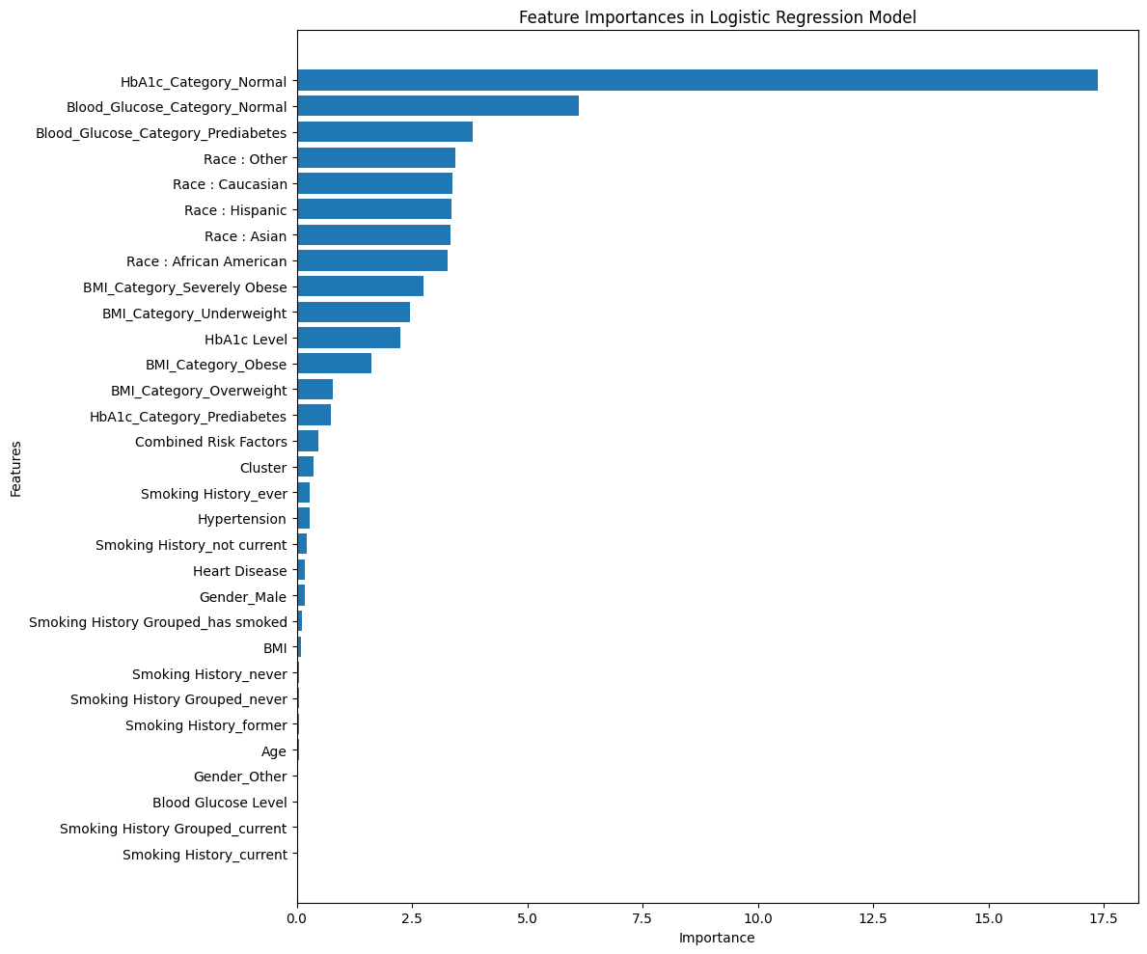

Slide 23
Model Optimization
Tested multiple models while comparing evaluation metrics
Iterated through features to find the optimal feature set
Applied weighting to LogReg model
Applied SMOTE to all models
Evaluation Metrics: Train/Test Accuracy, Recall, F1 Score, MCC, ROC-AUC, confusion matrix.
Key Metric: ROC-AUC
Hyperparameter Tuning on best two models

Slide 24
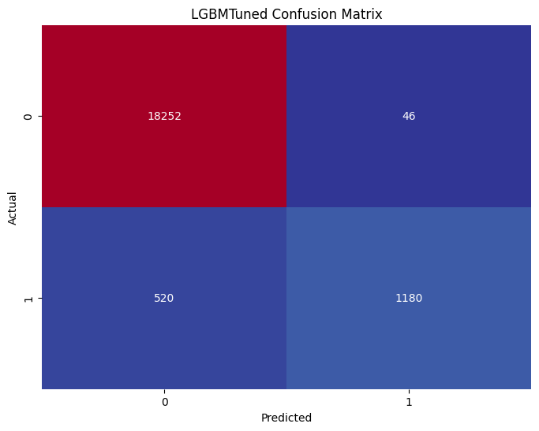
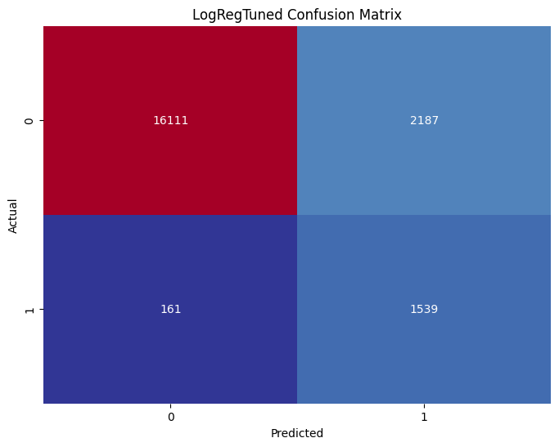
Final Model Performance
LightGBM Tuned Logistic Regression Tuned

Slide 25
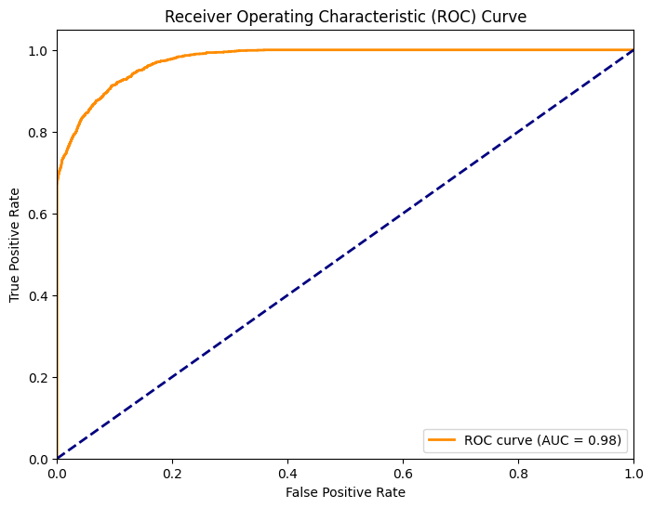
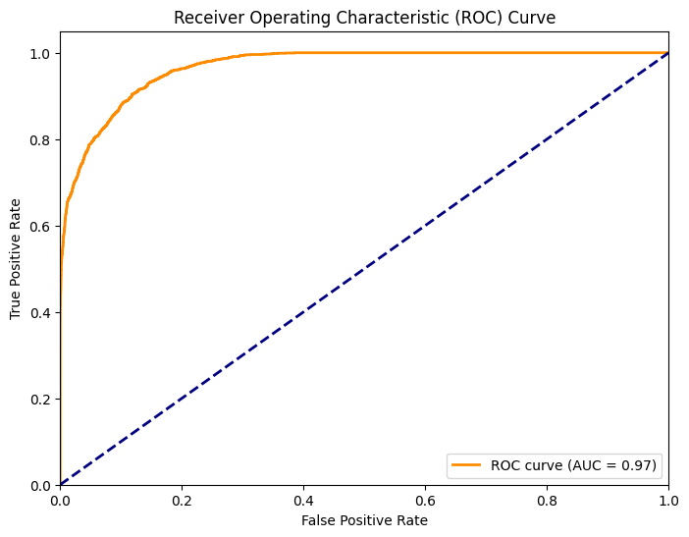
LGBM
Log Reg

Slide 26
Scoring Metric Comparison
Model | Train Acc | Test Acc | Recall | F1 Score | MCC | ROC-AUC
LogReg FullFeature | 0.973676 | 0.972197 | 0.697027 | 0.809537 | 0.807242 | 0.978107
LGBM Tuned | 0.972171 | 0.971697 | 0.694118 | 0.806562 | 0.804050 | 0.976868
LogReg Baseline | 0.97253 | 0.97216 | 0.68836 | 0.81076 | 0.81126 | 0.97590
LogReg Tuned | 0.883883 | 0.882588 | 0.905294 | 0.567269 | 0.562835 | 0.967205

Slide 27
Conclusions
Summary: Successfully built multiple models to predict diabetes with over 75% accuracy using this dataset.
Strong performance by logistic regression model suggests a linear relationship between features and the target variable
Also suggests low complexity in the dataset
Importance of scoring metric in tuning

Slide 28
Future Considerations
Improvements: Explore more complex models like neural networks or continue to tune.
Data: Use additional features or external datasets to improve prediction accuracy. More complex or real-life datasets.
Next Steps: Test the model on different populations to assess generalizability.

Slide 29

Thank You!
Resources and more info in:
GitHub Repository
Questions?

